Slide 1
Creating Accessible PDFs
Sylvia Sotomayor
Juli Maikai

Slide 2
What do we mean by accessible?
Machine readable
Can be read aloud by computer
Create an outline from headings
Extract images, links, tables, etc
Extract key words for search performance

Slide 3
Accessible 2
Readable by humans with accessibility issues
Be able to resize print
Distinguish foreground from background
Determine which information is more important than other info

Slide 4
In other words...
Pay attention to the STRUCTURE as well as the CONTENT

Slide 5
Perceivable
pictures and graphics have text equivalents
document has structure and a logical reading order
text can be distinguished from the background

Slide 6
Operable
everything works from the keyboard / no mouse!
headings are logical-like an outline
links are logical
tables have clear headers and no merged cells

Slide 7
Understandable
clearly written
no unexplained abbreviations
logical order

Slide 8
Robust
latest version of Word (docx vs doc)
good, clean design
no text boxes (if you don’t know what this means, good!)

Slide 9
Working with Word
In order to create an accessible PDF, first create an accessible Word document

Slide 10
Working with Word 2
Use the show hidden characters button

Slide 11
In General
Minimal formatting – don’t make it more complicated than it needs to be.
Underline links! Do not underline anything that isn’t a link.
Do not use all caps.
Be clear.
Use consistent vocabulary.

Slide 12
Follow Four Simple Steps:
L.I.S.T.
Links
Images
Styles
Tables

Slide 13
Links
name links logically
not "click here", not "for more information", not the url
tell people where the link goes or what is at the other end of the link
link text should be what you get if you click

Slide 14
Images
add alt text to images
alt text should be as brief as possible, often 3 words or fewer
borders and other graphic decoration also need an alt text
ask, why is the image here? Does it convey information?
If conveying information, include that information in the text as well
consider the intent of the image and the intended audience

Slide 15
Alt Text Guidelines
be objective
be brief
be descriptive
be logical
be accurate
use the same vocabulary as in the text

Slide 16
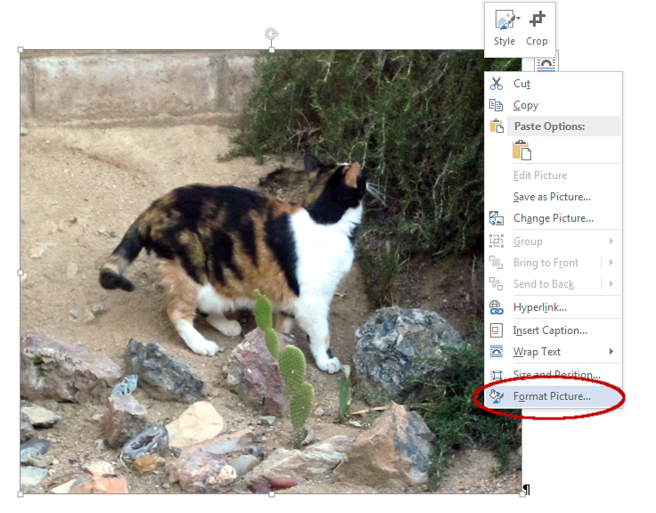
Create Alt Text
right click
format picture

Slide 17
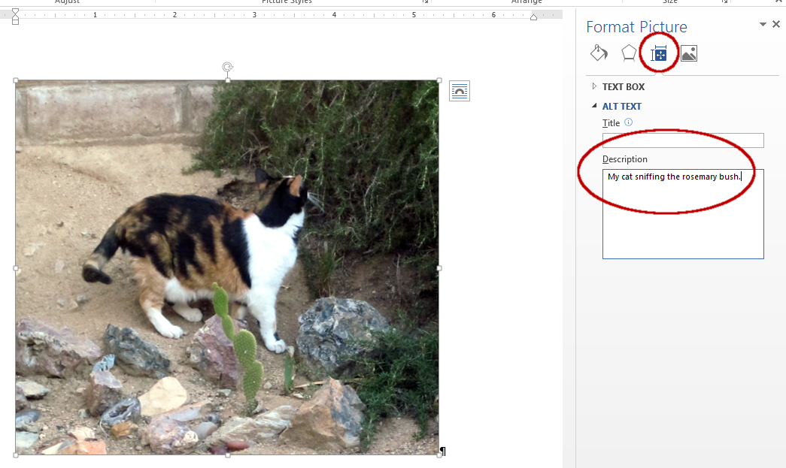
Create Alt Text 2
alt text
enter alt text into "description", ignore "title"

Slide 18
Charts
Charts are images!
They need alt text.
Easiest is to keep a table of data with the chart.
Then the alt text for the chart can be “chart for data in table”

Slide 19
Lines
Lines are images!
Every single line is a separate image.
A square is four lines.
Do not use, or use very sparingly.
Create complex drawings separately as a single image.

Slide 20
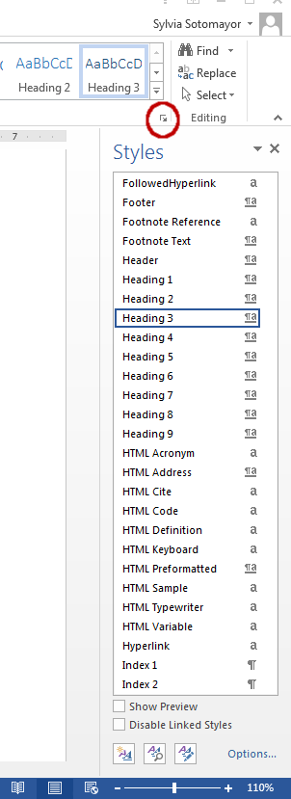
Styles
use styles for quick and easy formatting
paragraph styles vs character styles
underline all hyperlinks, do not underline anything else
modify styles, do not modify the Normal style

Slide 21
Styles 2
font size ought to be 12pt or better
be aware of color contrast
do not use the enter key for spacing (tab)
use headers - they provide navigation points (label as heading 1, heading 2, heading 3 etc) like an outline

Slide 22
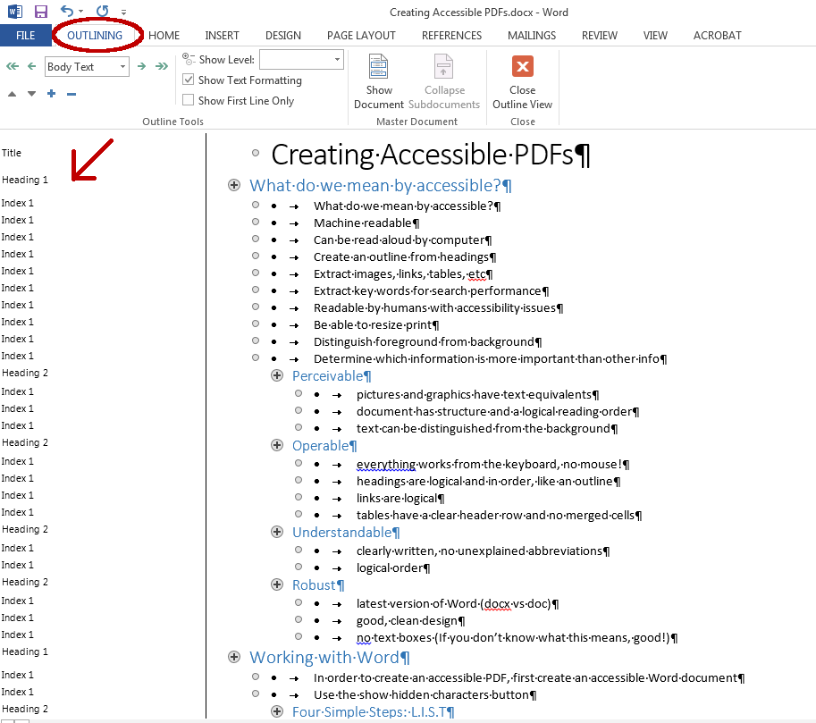
Headers
Check your headers in Outline Mode
View > Outline

Slide 23
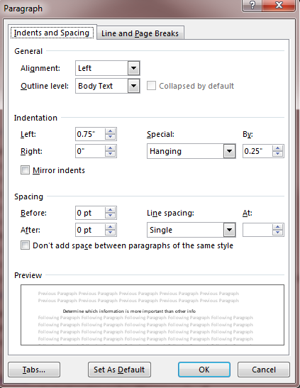
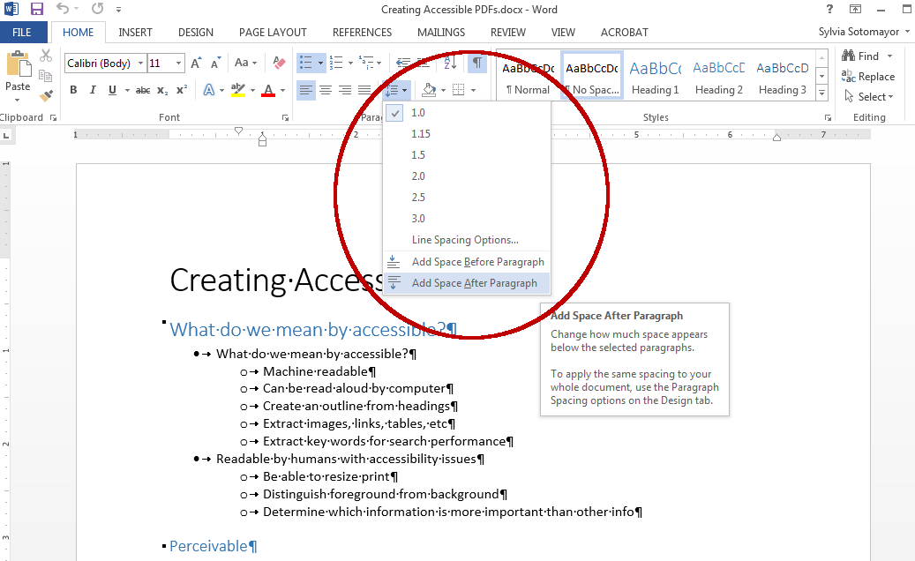
Paragraph Spacing
Add space before|after paragraph
Paragraph settings

Slide 24
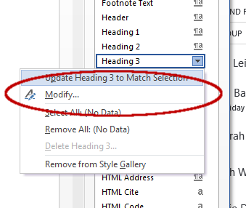
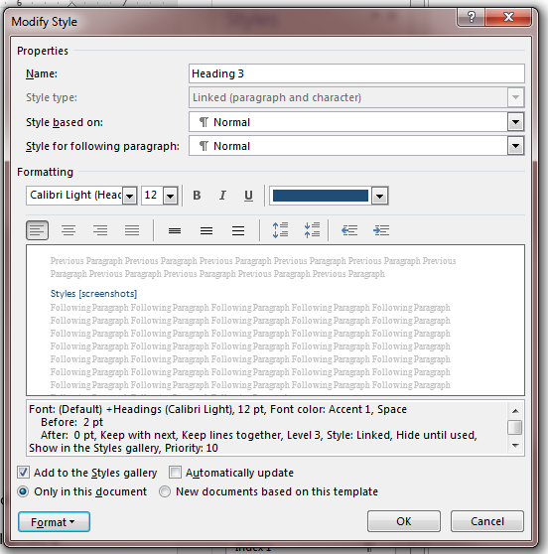
Modify Styles
You can modify styles to fit your own ideas

Slide 25
Tables
mark header rows

Slide 26
Tables 2
No merged cells
Do not use table just to get columns

Slide 27
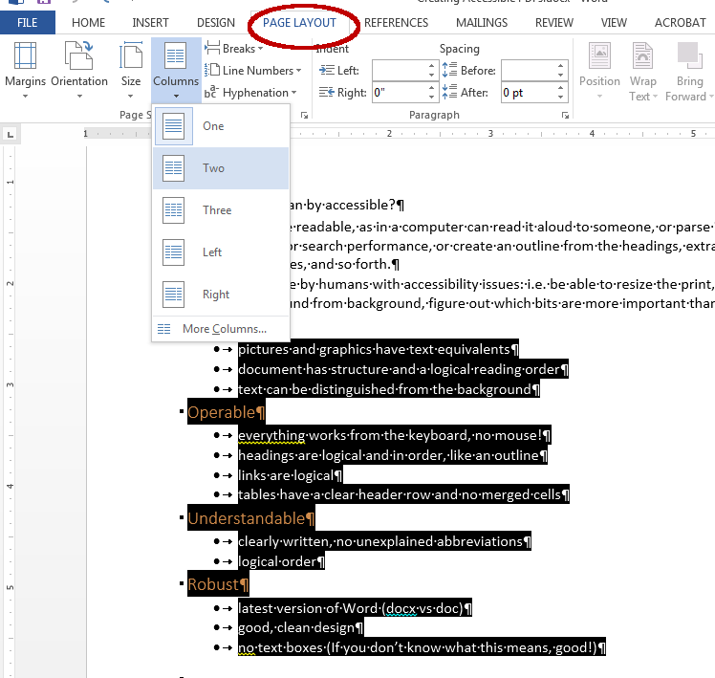
Creating Columns
Select your text
Page Layout > Columns

Slide 28
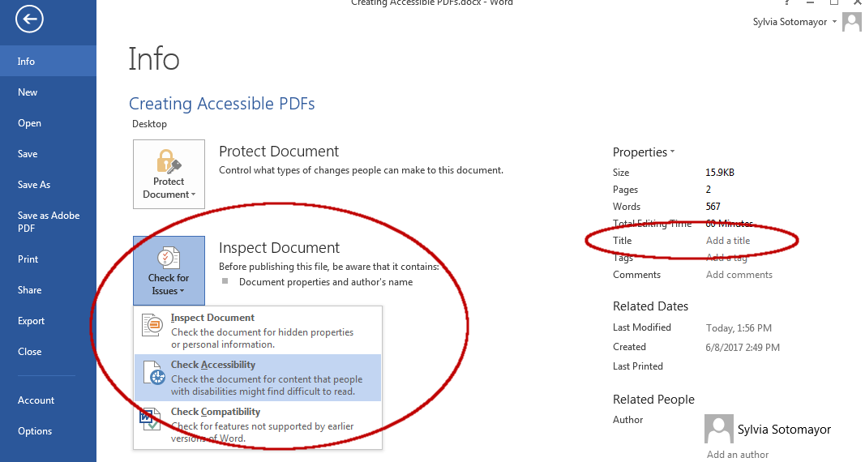
Next Steps
Run Word's built-in accessibility checker

Slide 29
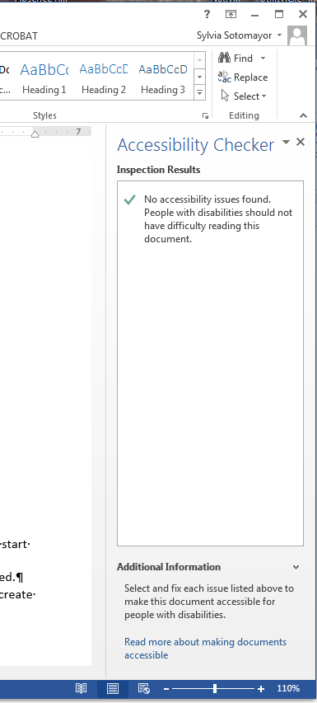
Next Steps 2
Fix whatever issues it finds!

Slide 30
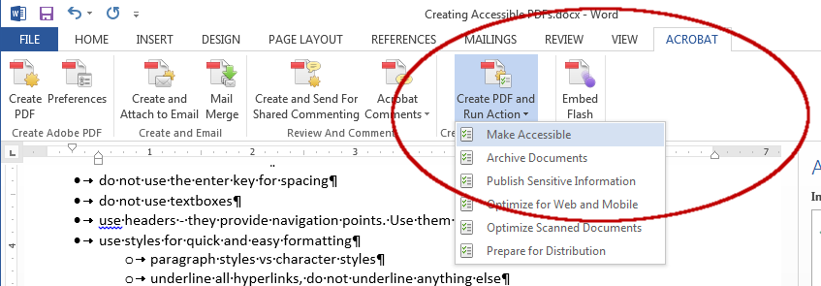
Next Steps 3
Then create your pdf

Slide 31
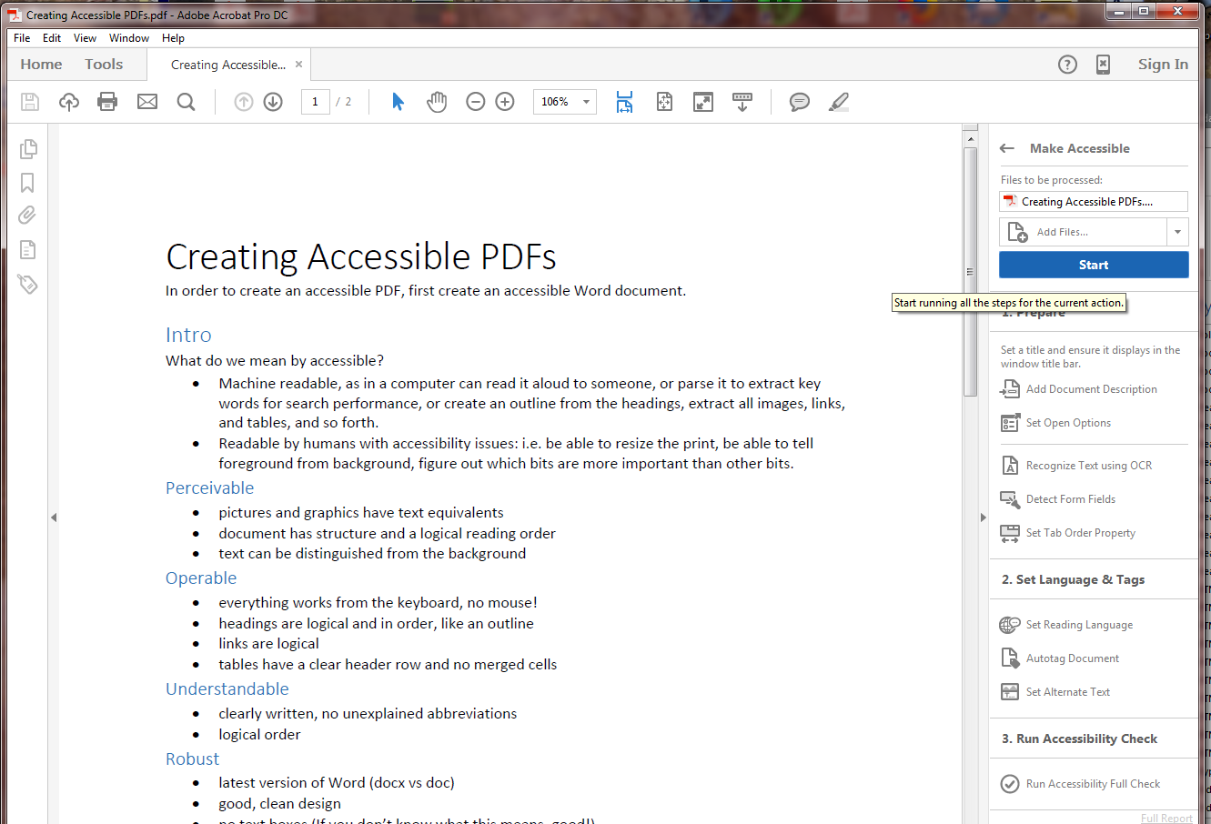
Make Accessible PDF
Hit “Start”

Slide 32
Accessible PDF continued
Run through the various dialogs (When in doubt, click OK)
Don’t detect form fields
Enter ALT text for any images that have no alt text
Under “Run Full Accessibility Check” you can unclick “Create Accessibility Report” then click “Start Checking”
Under “Document Issues” Logical Reading Order and Color Contrast will always be highlighted
If other items are highlighted, go back to Word doc, fix issues there, and re-create the PDF

